Slide 1

BDAT 1000 Data Manipulation Techniques
Final Presentation
Gun Violence in United States
Shubham Chawla
200493036

Slide 2

Dataset Information
Data Source - https://www.kaggle.com/datasets/jameslko/gun-violence-data
The dataset consists of more than 200K records with a good mix of quantitative and qualitative variables.
It contains gun violence data for the years 2013 to 2018, with variables such as location of incidents, gender of suspects and victims, casualty count, injury count etc.

Slide 3
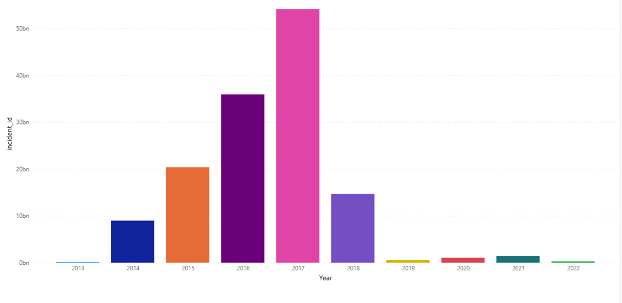
Data Cleaning
Missing data for 2013 and 2018

Slide 4

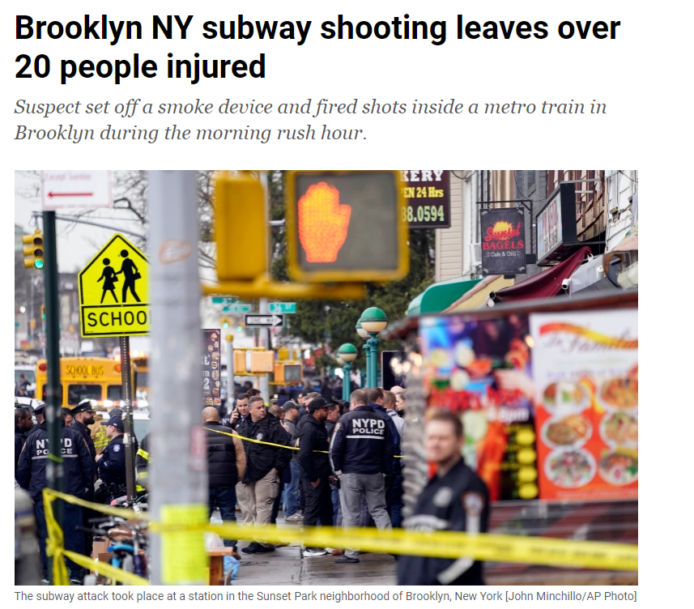
Reason for selecting this dataset
Source - ALJazeera

Slide 5

Tools Used
Microsoft Excel
Tableau
Microsoft PowerPoint

Slide 6

Data Dictionary
incident_id – unique id for each incident
Date – Date of the incident 2014-2017
State- State where the incident happened
n_killed = Number of Casualties
n_injured = Number of injured people
victim_gender = Gender data for Victims
suspect_gender = Gender data for suspects
Location – Location of the incident For e.g. - Walmart, Intl airport etc.

Slide 7

Analysis in Tableau

Slide 8

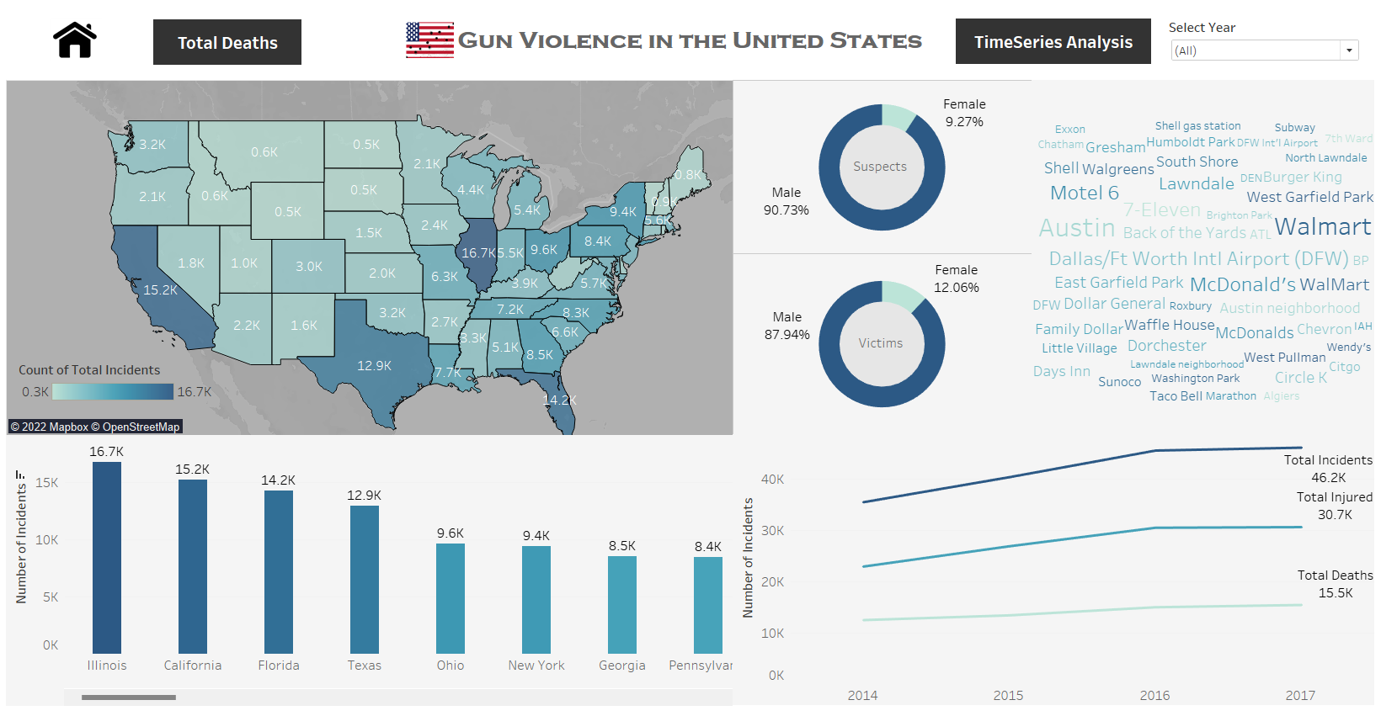
Dashboard - 1

Slide 9
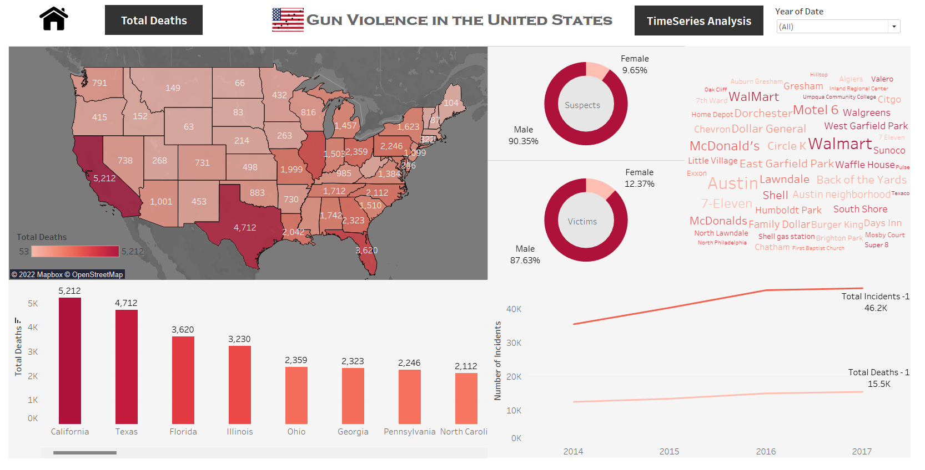
Dashboard - 2

Slide 10
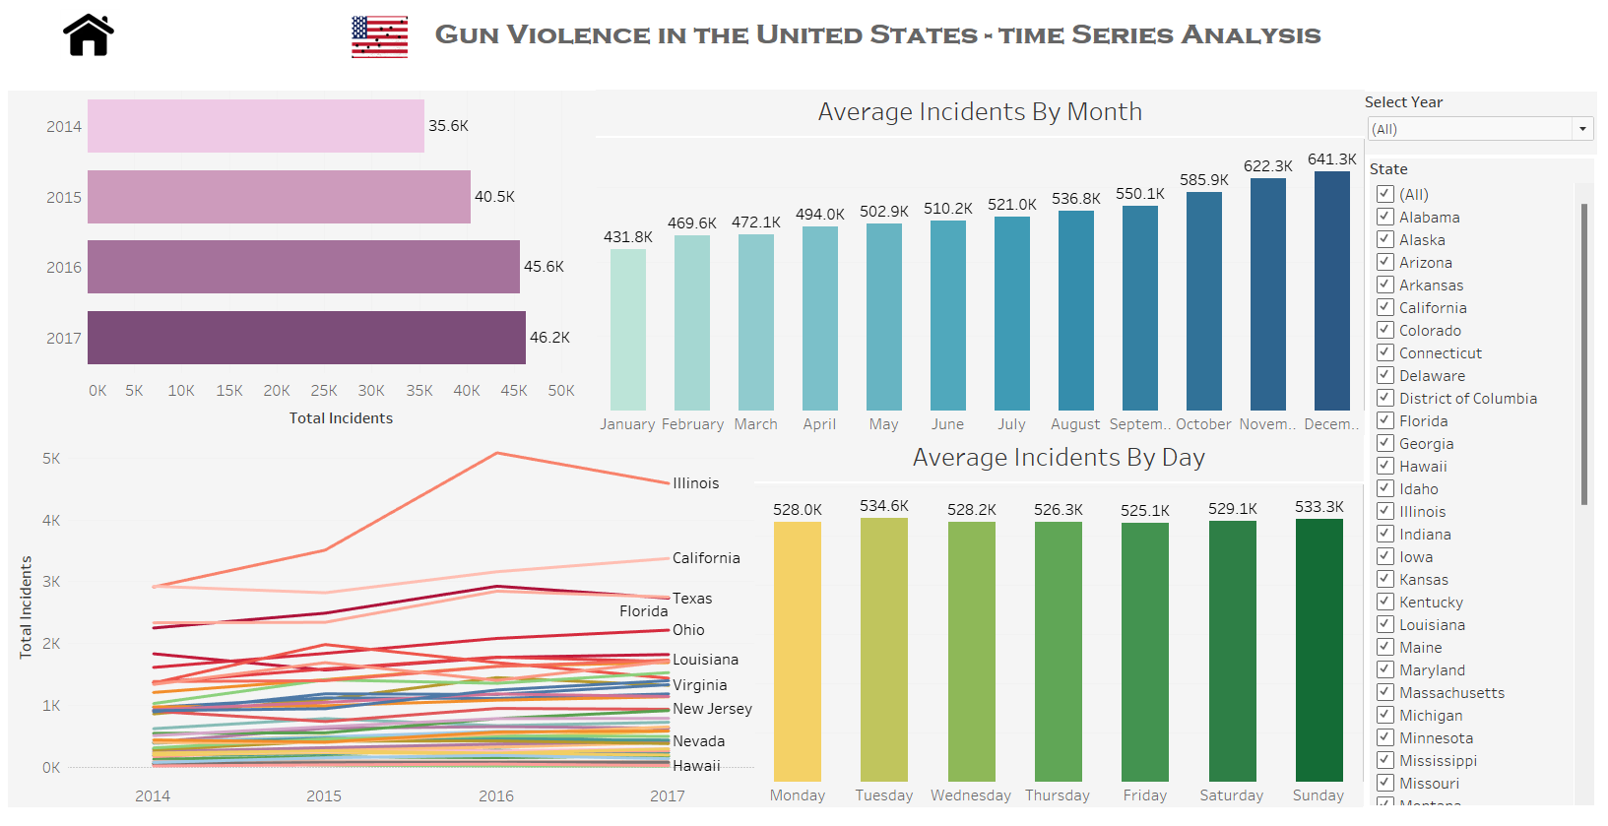
Dashboard - 3

Slide 11
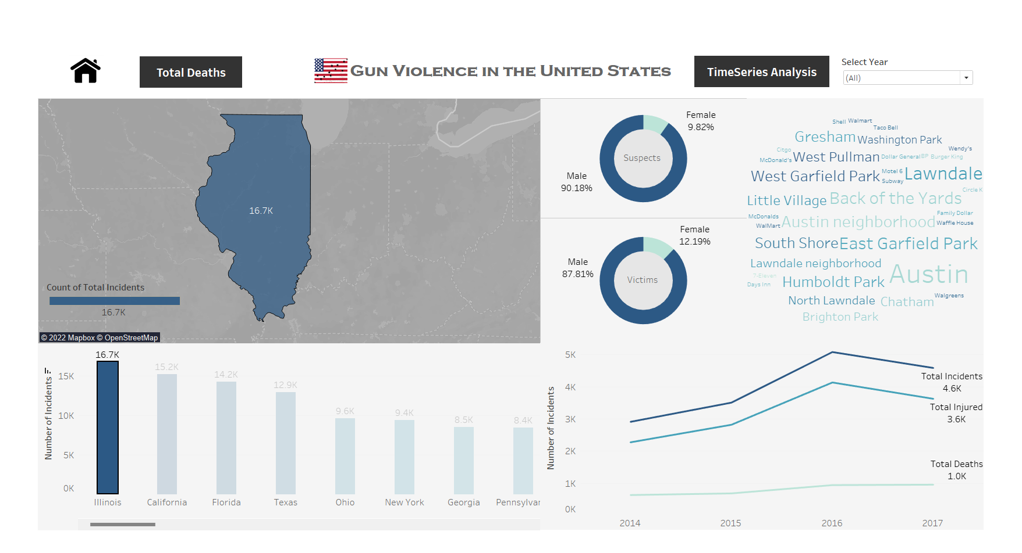
Q1 Which US city had the highest number of gun violence incidents from 2014-2017?
Which locations in that city were targeted the most?

Slide 12
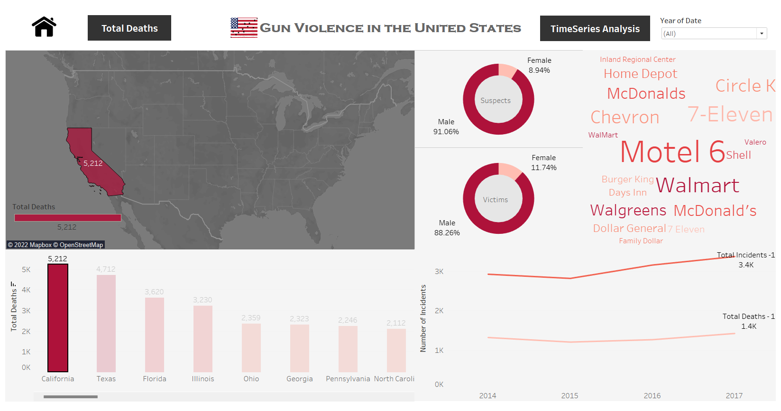
Q2 Which US city reported the highest number of casualties over the period 2014-2017? What was the demographic related to gender?

Slide 13
Q3. What does the gun violence trend show? Are we safe ???

Slide 14
Conclusion
Illinois had the highest number of gun violence incidents from 2014-2017 – 16.7K total incidents reported.
California had the highest casualty count – 5212 victims.
The genders of victims and suspects is skewed in one direction: both are primarily male.
Total incidents are rising significantly by year.
Incidents tend to increase as we approach end of the year
Looking at trend by Weekdays, gun violence incidents are observed more on Tuesdays and weekends.
The gun violence incidents trend is very disturbing and this will most likely increase in the upcoming years if there are no changes in the gun laws. For e.g., the legal age to buy a gun should be changed from 18 to 21.

Slide 15

Thank You

